Slide 1

Summer Project Journal
Sid Lamsal

Slide 2
Specifics
Dataset:
Telco Customer Churn
predict churn
Applications used: R-Studio, Jupyter Notebook

Slide 3
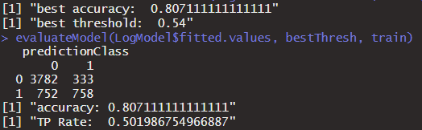
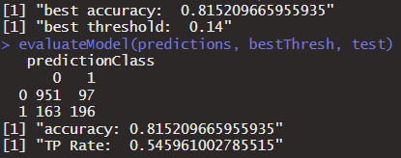
Base Log Model
Fit
Predict
Fairly similar fit and predictions. Model is significantly better at predicting “No”. “Yes” is 50/50 (i.e. Very bad)

Slide 4
R Neural Network
Package: neuralnet
Function: neuralnet()
To Edit source code: trace(name_of_function, edit = T)

Slide 5
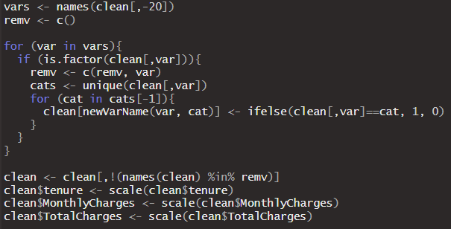
Data Prep For NN
- Had to change all categorical variables to dummy variables with
Class 1 = in that category
Class 0 = not in that category
- Scaled vars
- Dummy variable for n-1 categories

Slide 6
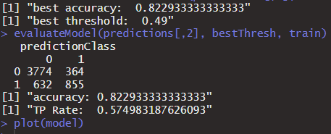
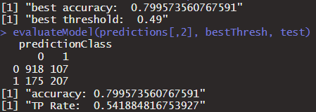
Base NN
Fit
Predict
2 layers with 4 and 2 neurons and threshold =0.1 (~28sec to train) (not the ideal model but still can measure improvements probably)

Slide 7
Switched to Python

Slide 8
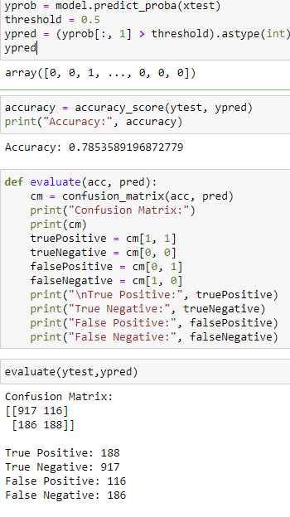
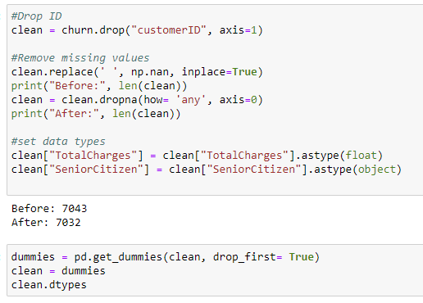
R -> Python

Slide 9
Possible Ways to Use Log Results

Slide 10
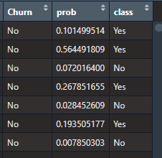
Oversample
1. Since “No” is significantly easier to predict, we could over/under sample.
2. Using the new variables, we can get all the missed units and oversample them.
3. We could do a hybrid where we oversample only the class “Yes” units that the model missed.

Slide 11
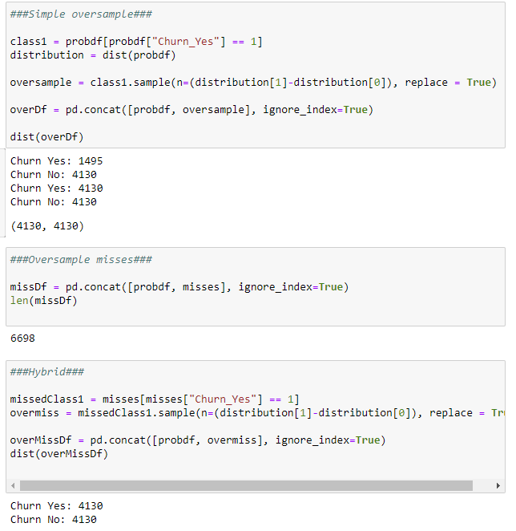
Oversampled Datasets

Slide 12
Similar Probabilities, Different Classes
Method 1:
Find a range of probabilities that that has both class0 and class1
The sample units in that range have similar probabilities but different classes
Issue: The range comprised of ~5000 units and the entire training set has ~5600 units. So, separating the 2 does not make a big difference
Method 2:
Find a sample unit with the closest probability, but in class 0
This way, the number of separated units is ~3000 out of ~5600

Slide 13
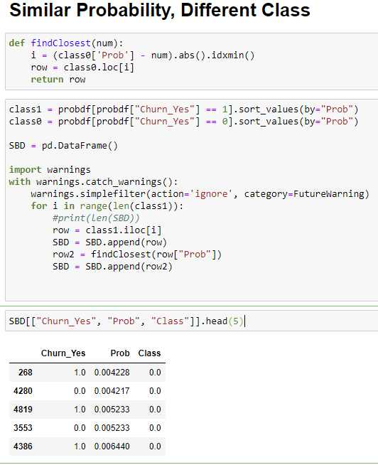
Similar Probabilities, Different Classes
- Took about 2-3 sec to run
-Should this be done with all training units in class 1or just missed units?

Slide 14
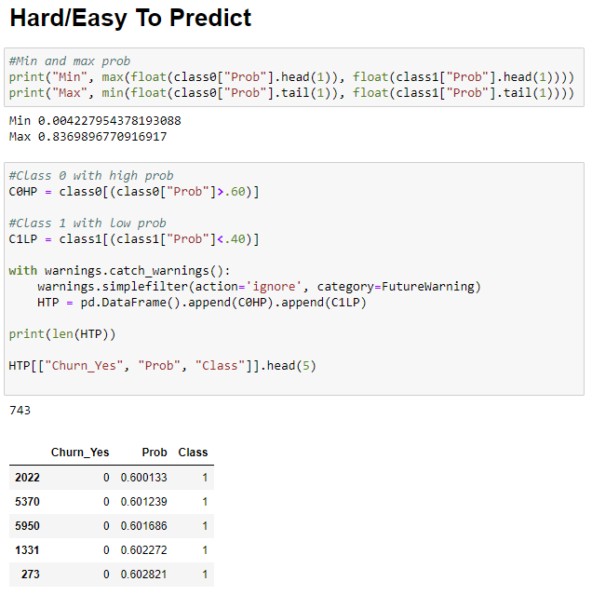
Hard to Predict
Hard to predict: High probability of class1, but class0 and vice versa
Easy to predict: Not hard to predict
The idea: The model was off by a lot with these sample units, so separating them might help
Expectation: It probably wont help the model since these units might simply be outliers.
There are not many in the hard to predict range

Slide 15
Hard to distinguish
Method:
Use some measure to determine how difficult sample units are to classify
Distance measures?
Work in progress

Slide 16
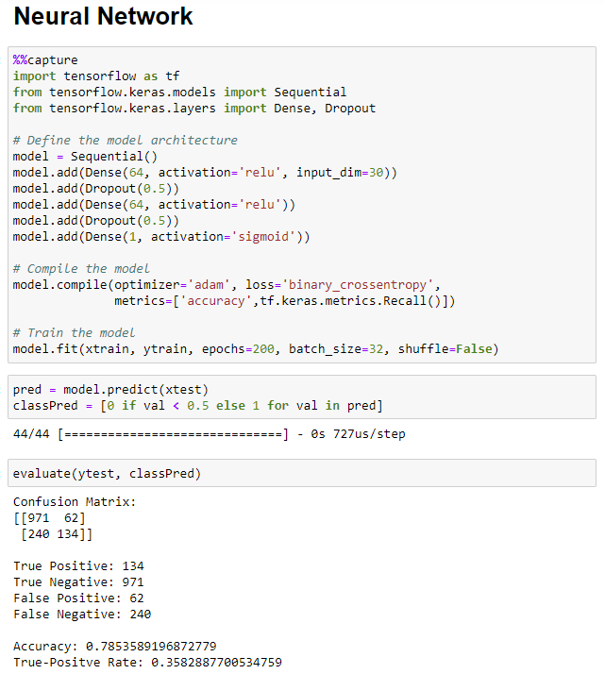
NN in Python
Can use shuffle = False to stop random sampling

Slide 17
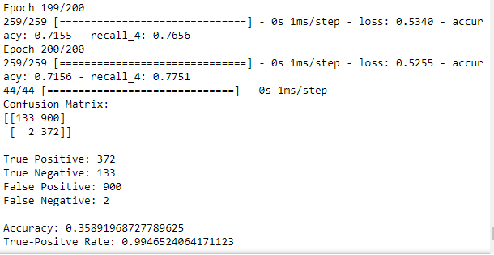
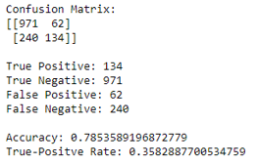
Results: Oversample

Slide 18
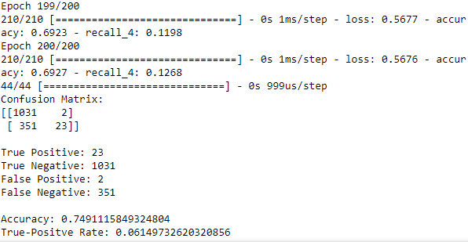
Results: Oversample Misses

Slide 19
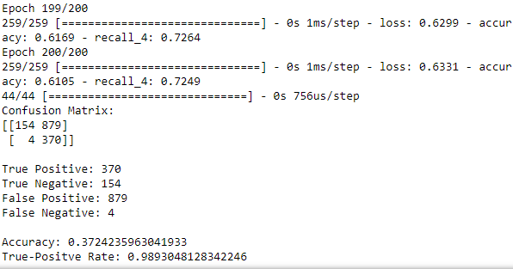
Results: Hybrid

Slide 20
Oversample Thoughts
Hybrid and oversample show clear signs of overfit since the recall and accuracy on training data is good.
Overall, this did not work
*note: I did not give the NN model the “prob” variable with Logistic probabilities

Slide 21
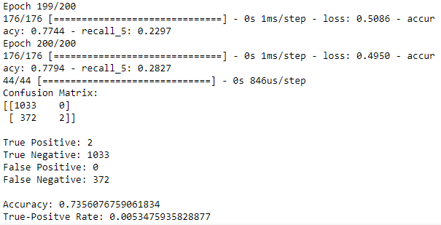
Results: Similar but Different

Slide 22
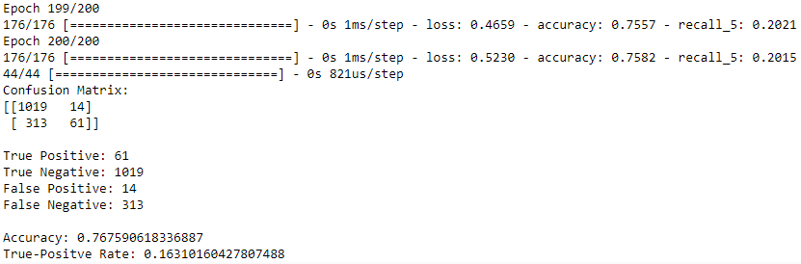
Results: Hard to Predict

Slide 23
Week 2

Slide 24
Goals
Shuffle
Thresholds
ROC curve and AUC values
Epoch graph
Batch graph
Error Weights

Slide 25
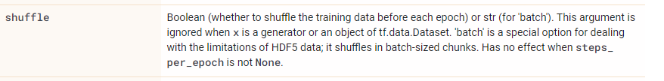
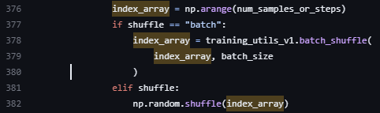
1. Shuffle
https://www.tensorflow.org/api_docs/python/tf/keras/Model#fit
https://github.com/keras-team/keras/blob/master/keras/engine/training_arrays_v1.py

Slide 26
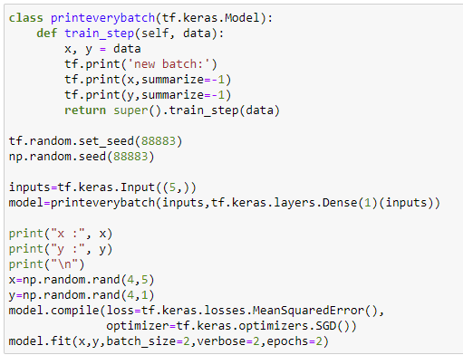
Further Investigation
This code modifies the train_step function so that it prints the x and y values in each batch
https://stackoverflow.com/questions/68115889/how-to-print-every-x-y-pair-used-during-a-tensorflow-training-model-fitx-y

Slide 27
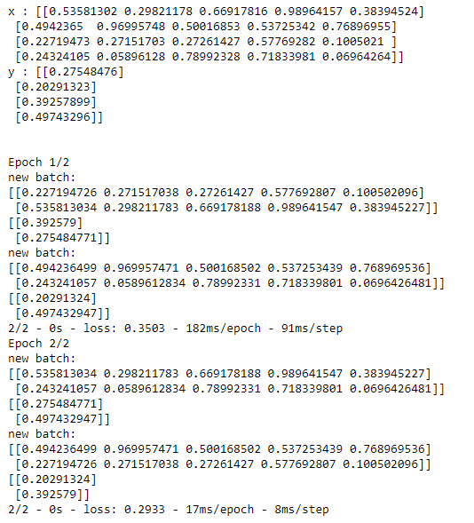
Shuffle = True

Slide 28
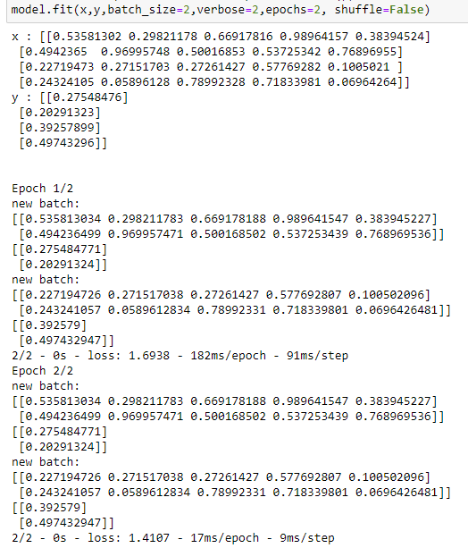
Shuffle = False
1
3
2
4
Perfectly in order
1
2
3
4

Slide 29
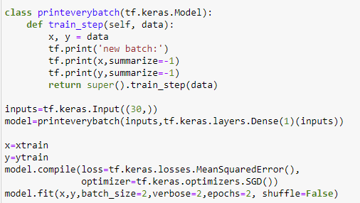
Apply to the Data

Slide 30
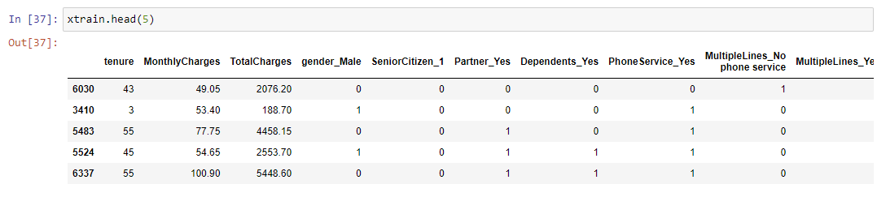
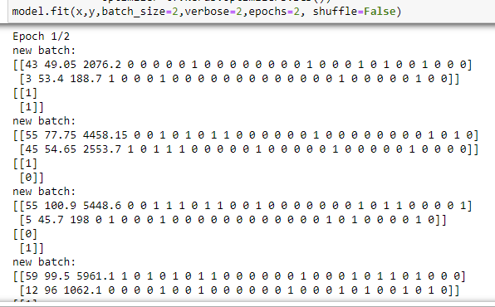
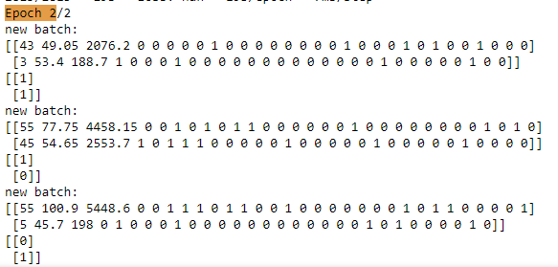
Experimenting With the Dataset
1
1
1

Slide 31
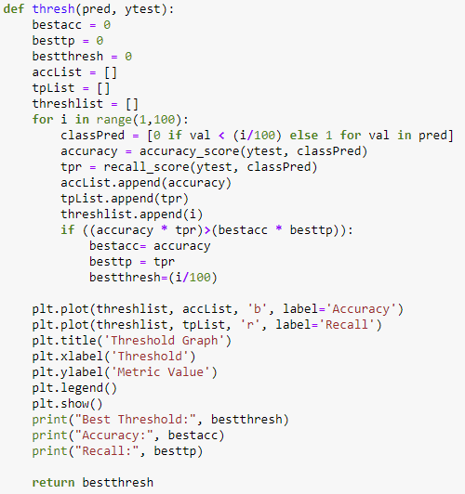
2. Thresholds
Multiplied acc and recall to try to consider both

Slide 32
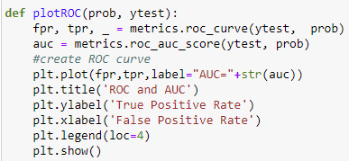
3. ROC and AUC
https://www.statology.org/plot-roc-curve-python/

Slide 33
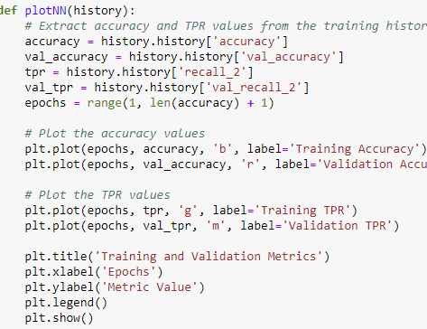
4. Epoch Graph
https://stackoverflow.com/questions/41908379/keras-plot-training-validation-and-test-set-accuracy

Slide 34
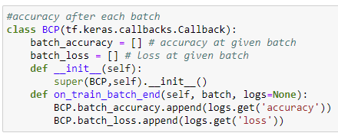
4.5: Batch Graph
https://stackoverflow.com/questions/66394598/how-to-get-history-over-one-epoch-after-every-batch
Accuracy after each batch (updates gradient)
Useful?
Required larger batches or less epoch to make graph interpretable

Slide 35
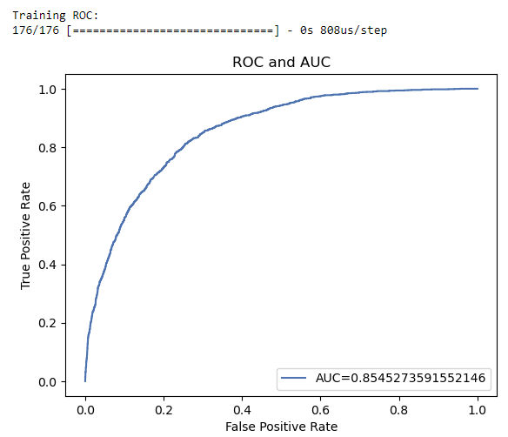
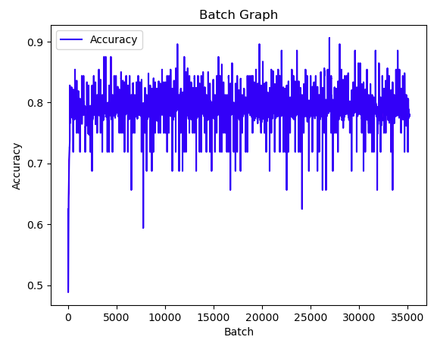
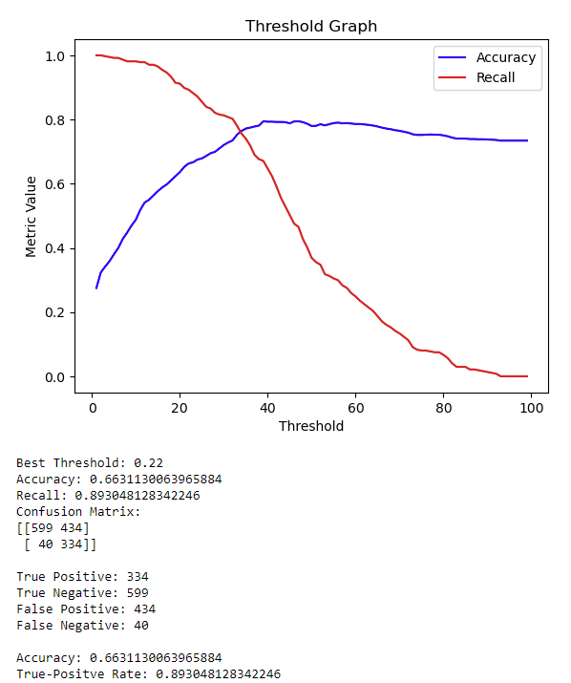
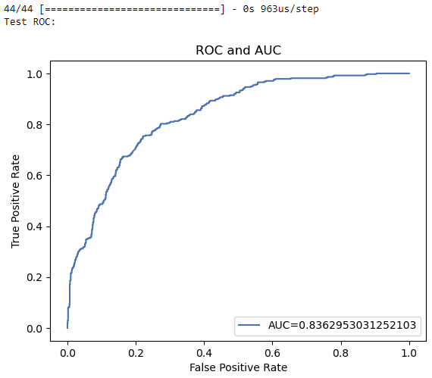
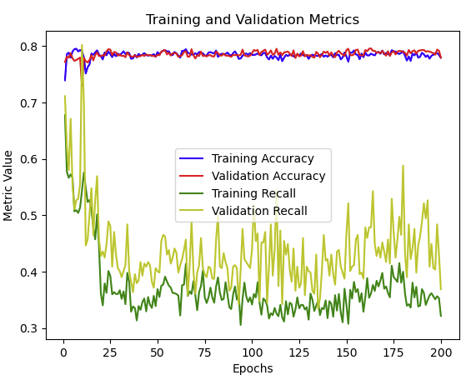
Results: Regular Dataset (200/32)

Slide 36
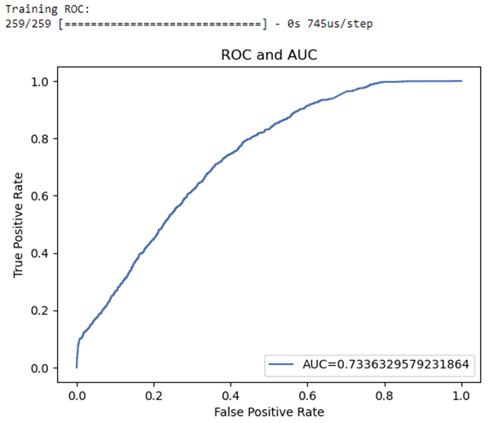
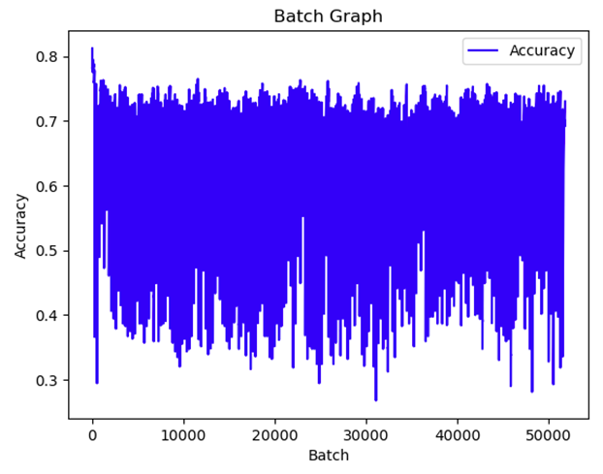
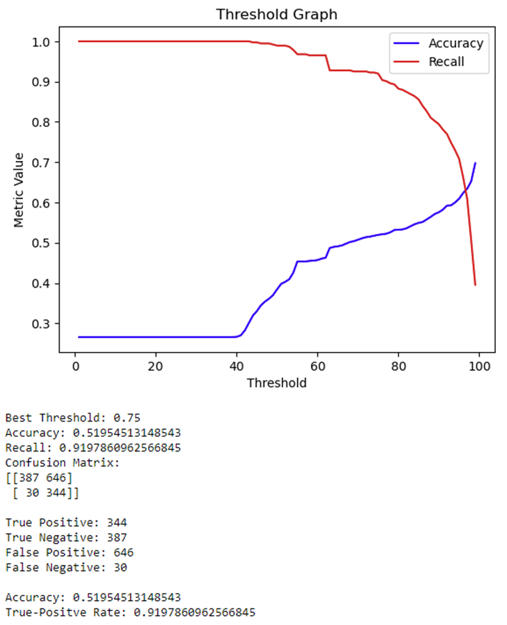
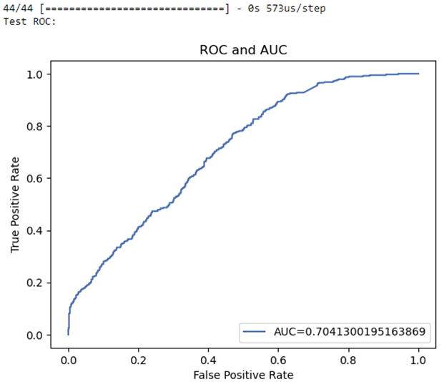
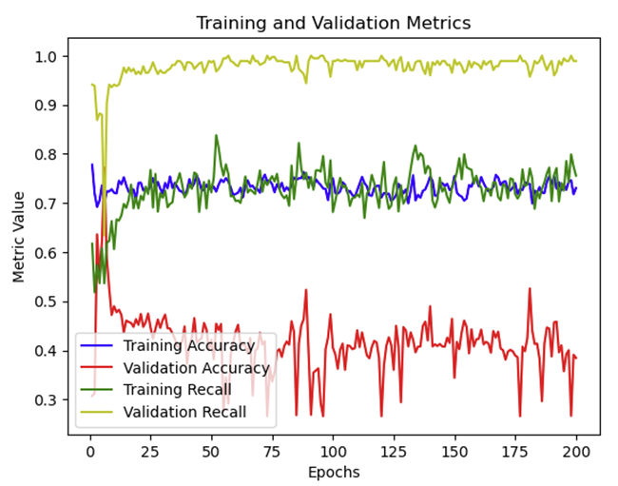
Results: Oversample

Slide 37
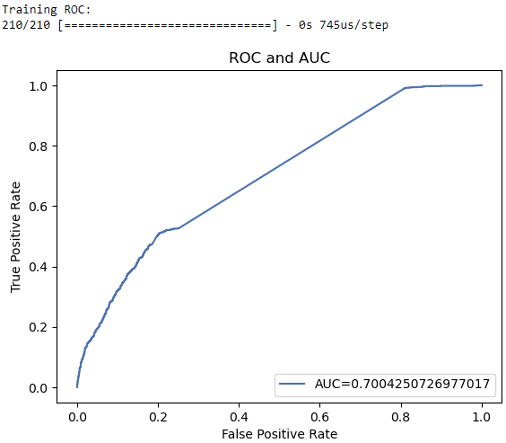
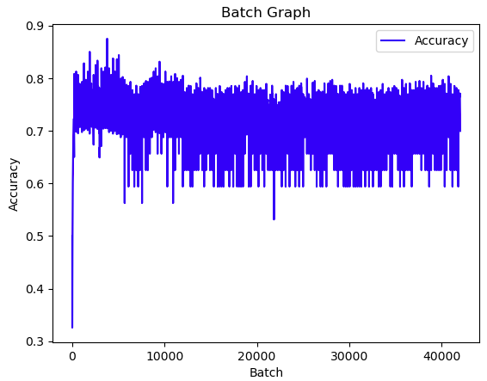
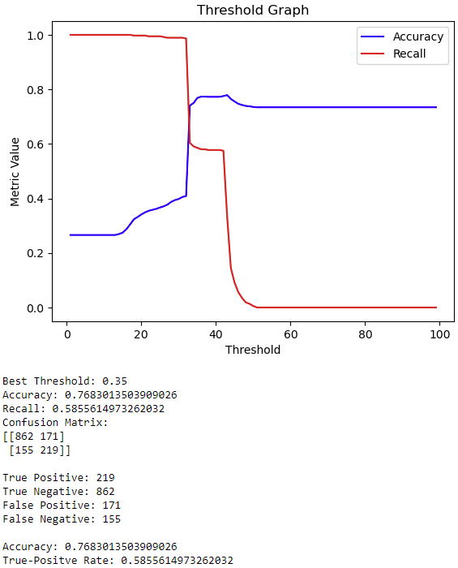
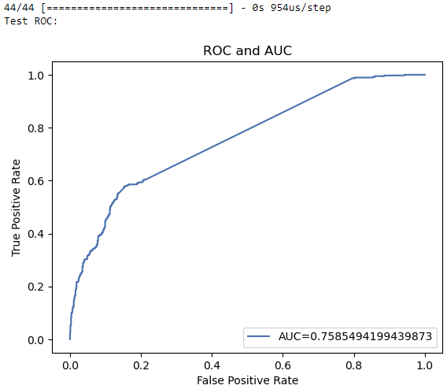
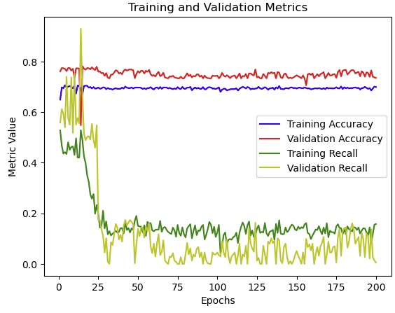
Results: Oversample Misses

Slide 38
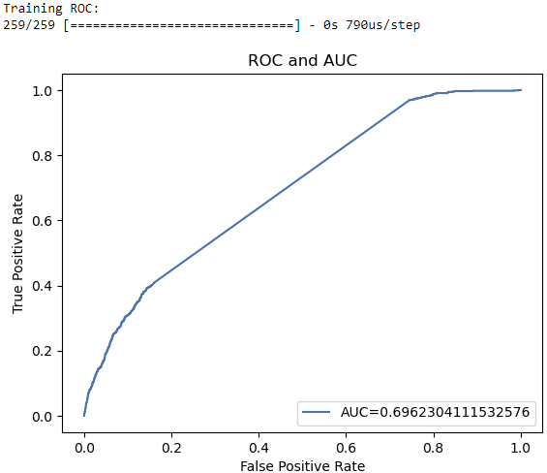
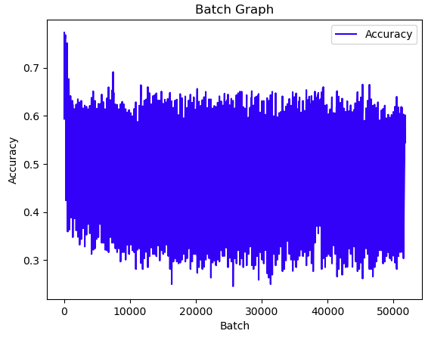
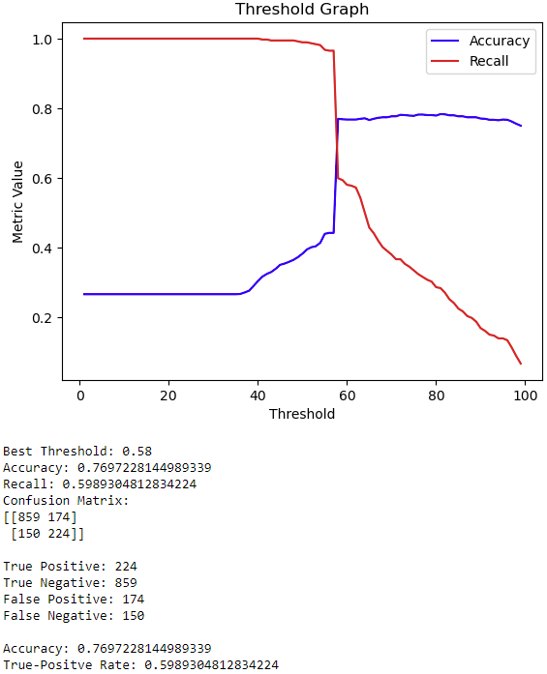
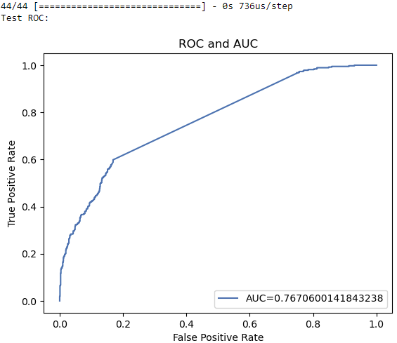

Results: Hybrid Oversample

Slide 39





Results: Similar but different

Slide 40





Results: Hard to predict

Slide 41
Conclusions
- Hard to predict and Similar but Different seem to improve the model
Showed signs of overfitting (high training recall and accuracy)

Slide 42




Easy First
Hard to Predict
Similar but Different
Feeding difficult sample units first seems to be more effective

Slide 43
To shuffle or not to shuffle
- By lowering the number of epoch and increasing batch size, we can create a better graph of the accuracy after each batch
- This will be performed with 3 data sets: oversample misses, similar but different, and hard to predict
- There will be 2 epochs, and batches will be 500 sample units

Slide 44



oversample misses
Shuffle
Don’t Shuffle

Slide 45
similar but different
Shuffle
Don’t Shuffle

Slide 46
hard to predict
Shuffle
Don’t Shuffle

Slide 47
Loss function
- We could create a loss function that penalizes missing hard to predict or similar but different sample units
Would have to identify where in the code the loss is calculated and how
Would have to provide access to the training data within a loss function
Write the function
Would have to go through the repo to make all other code compatible with new loss function

Slide 48




Changing loss function: Cran package
Missing “data”

Slide 49
How Cran NN Loss Function Seems to Work
neuralnet(data…)
calculate.neuralnet()
Needs access to data
rprop()
Loss function is defined
Predictions to use for loss
compute.net()
There is a bunch of other stuff not on the diagram

Slide 50


Work-around?
Instead of another loss function, how would doubling the number of Hard to Predict and Similar but Different sample units compare?
Hard to Predict
Similar but Different

Slide 51
Week 3

Slide 52
Goals
Threshold log model
Better metric
Reorder hard to predict
Hard to predict threshold
Duplicate Hard to predict
Ordering saves time? (converges faster) (graph both on same graph)
Cluster (graphs)
Decision tree
Methods
Harder to classify … why?
How to combine 2 neural networks

Slide 53

1. Threshold log model
What This changes:
“misses” dataset
Oversample misses
Hybrid oversample
Probability threshold for determining “Hard to predict”
What this does not affect:
Regular dataset
Regular oversample
Similar but different

Slide 54

2. Adding F1 score
Threshold is determined by F1 score
F1 score is logged after each epoch

Slide 55


Threshold & F1 Effects
Number of (training) misses
1073 -> 1203
Oversample Misses
6698 -> 6828
Hybrid oversample
Different missed sample units used
*note: test threshold = .36 | train threshold = .33
i.e. test set is not an outlier

Slide 56


3. Reorder Hard to Predict

Slide 57

4. Hard to Predict Threshold
“Hard to Predict” can be defined as 1/2 std from the threshold.
*note: did not use distance from mean probability since mean = 0.2657157437464206 and std= 0.24640093215331213

Slide 58




Updated Results
Regular
Oversample
Oversample Misses
Hybrid

Slide 59


Updated Results
Similar but different
Hard to predict

Slide 60



5. More Hard to predict
Single
Double
Triple
Quadruple
Note* HTP contain about double the amount of class 0 compared to class 1

Slide 61
Conclusions
F1 score based thresholds increased accuracy on class 0 sample units

Slide 62


6. Batch graphs
Note: Batch graphs (and epoch) with F1 were added after the completion of this slide (did not have time to update)
Also, considered adding a graph of the change in the metric (differenced graph)
Also, probably should have used more batches to show model progression
Hard to predict
Similar but different
Accuracy

Slide 63


7. Cluster

Slide 64



9. Graphs of Similar but different vars

Slide 65







Slide 66







Slide 67







Slide 68







Slide 69
Conclusion
The graphs show that, for the similar but different sample units, the reason they are hard to distinguish is because none of the categorical variables give a clear indication as to which class the unit belongs to
For example: If a SBD customer has phone service they are about equally likely to be in class 1 or class 0
This is similar for all SBD variables

Slide 70


Graphs of Hard to Predict
In many of the hard to predict variable graphs, variables seem to be more useful.
Ex: If a HTP sample unit has a one-year contract, then they are much more likely to be in class 1 than class 0
If a HTP sample unit has a two-year contract, then they are in class 1

Slide 71
Conclusion
If we perform preprocessing to determine hard to predict sample units, a specialized (HTP) neural network should theoretically be able to take advantage of the significant variables to make predictions on otherwise hard to predict units
To get a better visualization of which variables are important, we can use trees

Slide 72
Decision Tree
Specifics: used all variables and did not specify max depth, learning rate = 0.1
Did not evaluate tree effectiveness due to time limitations (planning on doing this)
Did not print tree due to size

Slide 73

Full Dataset Tree

Slide 74

Tree: SBD

Slide 75

Tree: HTP

Slide 76
Conclusion
Seems like categorical variables are not very useful for the SBD units compared to the HTP units

Slide 77





Combine 2 NN
NN2
- Separate Hard to predict and not
- Train 2 models
- Using test data, determine if the sample units are closer in distance to HTP or regular
- get prediction from respective NN
- similar to support vector idea
NN1 handles sample units that are similar to data points away from the support vectors
NN2 handles sample units similar to sample units within support vector range
Maybe we use SVM instead of Log model?
Similar to time series data: Use NN to find pattern in “non-stationary” data
NN1
NN1

Slide 78
Week 4

Slide 79
To-Do List
Weighted probability sampling
Boundary sample units (possibly save)
Randomness in the test set or NN (run multiple times w/ diff test and train) (bootstrap test)
Validation set accuracy
Calculate tree metrics
Boosting with 1 var each tree
2 NN

Slide 80
1. Weighted probably sampling
Method 1: order the training data so that is consists of n batches with m units. Each batch will be sampled using weighted probabilities. Then feed the data into a NN with shuffle = false, and make the batch size = m. This way, each batch is sampled with a weighted probably, and its faster to implement than editing source code
Downside: each epoch is still the same <- (working on it)

Slide 81


1. Weighted probably sampling

Slide 82

Proving that #1 works

Slide 83

2. Boundary sample units
Range: threshold +- .5*ST.D.
# of rows: 1104 (HTP~700)

Slide 84
3. Randomness in the test set & NN
Same training and test set
*Correction from last week, the test and training set have stayed the same entirely
Test run | Test F1
1 | 0.6217494089834514
2 | 0.6310559006211179
3 | 0.6195899772209567
4 | 0.6248548199767712
5 | 0.6279357231149567

Slide 85


Interesting:

Slide 86
3. Randomness in the test set & NN
Random training and test set
Test run | Test F1
1 | 0.6073697585768741
2 | 0.6347150259067358
3 | 0.6083086053412462
4 | 0.6274065685164212
5 | 0.6272321428571428
6 | 0.6409691629955947
7 | 0.6477272727272728
8 | 0.6513157894736842

Slide 87

3. Bootstrap Test set

Slide 88

4. Validation set batch graph
Need custom call back

Slide 89


4. Validation set batch graph
validation_data was coming up “none”

Slide 90


4. Validation set batch graph
Changed to .5
Should it calculate the best threshold?

Slide 91
Results combining everything
Using random weighted sampling (RWS), we can plot the batch graph showing the validation set f1 at the end of each batch. At the end, we can then bootstrap the test set to get the overall f1.
Using the following DFs: HTP (RWS), save (RWS), SBD (Haven’t figured out how to RWS)
*Note: Training takes forever with added computation on every batch, so the number of epochs is drastically lower (200-> 5) and batch size is increased (32->50). ie. Expect worse performance and possibly higher variance

Slide 92


Regular(SH)
Bootstrapped: 0.6151338702764233

Slide 93




HTP(RWS)

Slide 94



Save(RWS)

Slide 95



SBD

Slide 96

5&6. Tree Metrics/GBM

Slide 97



Tree results: Full Dataset

Slide 98





Tree results: Just SBD
Numerical variables
Able to separate sample units with similar probabilities but different classes really well (overfit)
Imp cat. vars. are intuitively irrelevant
High Test F1
Just SBD trained can predict whole test set well

Slide 99



Tree results: Just HTP

Slide 100



Tree results: Just save
Slide 100

Slide 101
7. 2NN
3 ways to use specialized models for test sets
Find some way to determine which sample units bet fit specialized criteria (which ones are HTP) and get prediction from respective model
Use weights
Use a NN to determine if the sample unit is HTP
To test if option 1 or 3 works in practice, I will find which sample units are HTP in the test set as a check to see if feeding into specialized models actually works
In an effort to allow for more training of the NN, I will not be recording per-batch data

Slide 102




7. 2NN: Save
Save NN
Not Save NN
Total

Slide 103



7. 2NN: HTP
HTP NN
Not HTP NN
Total

Slide 104
Conclusion
NN is really good at predicting and training on HTP and not HTP separately
Only problem is how to separate actual test set data into HTP and not HTP
NN to predict HTP?
Maybe try trees?
Also, stopped here because this week was getting very long
Didn’t have time to finish trying trees
STOP

Slide 105
Week 5

Slide 106
To-Do
1. Recompile model before fit
2. Weighted shuffle after each epoch
3. How to use for test set
See if one model has a pattern with how they deal with HTP
Weighted prediction
HTP Tree
4. Different dataset for separating (imbalanced)

Slide 107


1. Recompile model before fit
Test: Run a 1 epoch model 200 times, record test accuracy
Recompile
Same Model

Slide 108
Good News and Bad News
Bad news:
This could invalidate everything done up to this point …
Good news:
If training the same model on different permutations of the same data frame results in better performance, then this still is a good model, just much slower to train
All the code and theory is there, it just has to be re-run
We can simply re-make weighted shuffle dfs to train the model instead of messing with well written, highly optimized code
The first graph is essentially a 1 epoch training each time which shows high variance

Slide 109
Changes to Functions
def WNN(high, low, xtest, ytest):
# Define the model architecture
model = Sequential()
model.add(Dense(64, activation='relu', input_dim=30))
model.add(Dropout(0.5))
model.add(Dense(64, activation='relu'))
model.add(Dropout(0.5))
model.add(Dense(1, activation='sigmoid'))
# Compile the model
model.compile(optimizer='adam', loss='binary_crossentropy',
metrics=['accuracy', f1_m])
BCP.batch_accuracy.clear()
BCP.batch_f1.clear()
val_data = (xtest, ytest)
accuracy = []
val_accuracy = []
f1 = []
val_f1 = []
epochs = range(1, 201)
for i in range(200):
df = weightedBatches(high, low, 5, 32)
#print(df.head(1))
xtrain = df.drop("Churn_Yes", axis=1)
ytrain = df["Churn_Yes"]
history = model.fit(xtrain, ytrain, epochs=1, batch_size=32, shuffle=False,
validation_data=val_data, callbacks = [BCP()], verbose=0)
accuracy.append(history.history['accuracy'])
val_accuracy.append(history.history['val_accuracy'])
f1.append(history.history['f1_m'])
val_f1.append(history.history['val_f1_m'])
Recompile model before fitting
Use training threshold for everything
2. Weighted Sampled:

Slide 110












DF | Train | Test | Epoch Graph | Batch Graph
Regular SH
Over SH
Over-Miss

Slide 111












DF | Train | Test | Epoch Graph | Batch Graph
Hybrid SH
HTP
SBD

Slide 112












DF | Train | Test | Epoch Graph | Batch Graph
Save
Weighed Sample HTP
Weighed Sample Save

Slide 113



3. Specialized Models
Very similar performance even when model is recompiled:

Slide 114



3. Specialized Models
Using a Gradient Boosted Tree and NN:
Note: Using 2 trees also had good performance, seems like specialization is the key more so than the type of model used. Also note, GBM predict() uses .5 threshold which I did not change

Slide 115


3a. Probability spread HTP
Tree
NN
Purple = 0

Slide 116


3a. Probability spread Regular
Tree
NN
Purple = 0

Slide 117
3a. Probability spread
The models are really bad at predicting the other dataset, so in a test set, if one model gives a particular sample unit a high probability, it really does not mean much, nor can we use the probabilities given by the two models to decide who classification to pick

Slide 118

3b. Weight
This strategy applies a weight to the probabilities from the NN and tree and then combines them to find the best threshold and weight which try to combine the specialized predictions

Slide 119


3b. Results
Test

Slide 120
3b. Conclusion
This did not work because the HTP model is too specialized. It was so bad at predicting other sample units that it got very little weight (0.3) and so the performance was just the NN performance.

Slide 121

3c. HTP Tree
Summary: Use a NN to predict HTP units and then feed into specialized model

Slide 122

3c. HTP Tree Results
HTP is not very predictable by a tree, as such, the sample units separation is difficult

Slide 123
4. Try another dataset
https://www.kaggle.com/datasets/mnassrib/telecom-churn-datasets?select=churn-bigml-80.csv

Slide 124




4. Try another dataset
Before
HTP Tree
Regular NN
After

Slide 125
Conclusion
Specialized models seem to work good in theory, but trying to separate the test set is difficult. Could there be some way of creating specialized models that works with a real test set?(Probably (pie charts), but it will likely be very situational)

Slide 126
Week 7

Slide 127
To-Do
1. centroid using numbers and categories
2. 3 neural networks (or tree) (SBD)
3. tie breaker neural network trained on everything
4. Listen to who is more certain

Slide 128



4. Listen to who is more certain
HTP
Reg
Total

Slide 129




3. tie breaker neural network trained on everything
HTP
Reg
Every
Total

Slide 130






2. 3 neural networks (or tree) (SBD)
[[746 118]
[ 91 188]]

Slide 131
1. Kmed
Idea1 (idea on to-do list): use kmed. to cluster HTP units into one cluster. Also, cluster notHTP units into one cluster. Then calculate the distance of the test units to the middle of each cluster. Which ever cluster the test unit is closer to will be the model that predicts the sample unit.
Idea2: Make clusters of entire dataset (2-4). Make a corresponding model for each sample cluster. Cluster fit test units and feed to closest model for prediction. This method removes the reliance on the arbitrary “HTP” distinction. (Next week?)

Slide 132

1. Kmed

Slide 133



1. Kmed
HTP
Reg
Total

Slide 134

1. Kmed
Why did it not work? HTP units were closer to not HTP units
CM showing predicted HTP vs real HTP

Slide 135
More possibilities
We could work with the distance from the medoids to assign which model handles the sample unit. For example, if a sample unit is within x distance from the HTP cluster medoid, the it is predicted by the HTP model (repeat for n clusters). Any sample unit that does not fit in any category is predicted by a NN trained on everything.
We could try method 2: random clusters (removes reliance on “HTP” label)

Slide 136
Week 8

Slide 137
To-Do
1. Threshold HTP network
2. Random cluster
3. Threshold distance
4. Retry different probability NN*
5. Use more complex NN as benchmark
6. Try using simpler models, see if you get consistent results

Slide 138





2. Random cluster
Didn’t work.

Slide 139


2. Random cluster
Some cluster probabilities were too similar
(The ones that had poor performance)

Slide 140






5. Use more complex NN as benchmark
More complex
Current
Less Complex (32 neurons)
128 Neurons

Slide 141




4. Retry different probability NNs
DP
Total
HTP
Not HTP

Slide 142



6. Try using simpler models, see if you get consistent results
Tree HTP
Log HTP
NN not HTP
Log not HTP

Slide 143


1. Threshold HTP network
Black line shows best threshold for predicting which units are HTP
As threshold increases, the number of notHTP increases and f1 increases, meaning the best f1 is when no HTP model is being used

Slide 144

3. Threshold distance
The ability of clustering to predict HTP is about the same as the NN (not good)

Slide 145
Week 9

Slide 146
To-Do
1. Train on just notHTP and see if it can perform better than original (different test sets)
2. Oversample HTP-predicting network
3. Use most important variables from tree as proxy to determine which are HTP
4. standardize cont.
5. try k nearest (if can’t use cat, use just num vars)

Slide 147






1. Train on just notHTP and see if it can perform better than original (different test sets)

Slide 148


4. standardize cont.
Got worse?

Slide 149




2. Oversample HTP-predicting network
Did not Work

Slide 150

5. try k nearest (if can’t use cat, use just num vars)
HTP predictive power is still Bad with KNN

Slide 151



3. Use most important variables from tree as proxy to determine which are HTP

Slide 152



Histograms of Numerical variables

Slide 153








HTP
notHTP

Slide 154








HTP | Var0 = HTP0 | Var1 = HTP0
notHTP

Slide 155








HTP | Var1 = HTP0 | Var1 = HTP0 |  | Var1 = HTP0
notHTP

Slide 156








HTP |  | Var1 = HTP0 |  | Var1 = HTP0
notHTP

Slide 157








HTP |  | Var1 = HTP0 |  | Var1 = HTP0
notHTP

Slide 158








HTP |  | Var1 = HTP0 | Var1 = HTP0
notHTP

Slide 159






HTP |  |  |  | Most useful pie charts result in “Var1 = HTP0”. This might not be enough to properly distinguish the two classes
notHTP

Slide 160



Performance

Slide 161


Performance using HTP NN

Slide 162
Week 10

Slide 163
To-Do
1. Compare customers that all (regular, notHTP, Separate HTP/notHTP, pie charts, perfect, log model) missed
2. Make arguments
- NN time need is too much compared to performance
- Separating HTP and notHTP leads to good performance, but its hard to separate

Slide 164


1. Compare misses

Slide 165



1. Compare misses

Slide 166



Conclusion 1
For simpler/smaller binary classification, the time needed for neural network is not worth the marginal improvement.

Slide 167

Conclusion 2
Separating HTP and notHTP leads to good performance, but its hard to separate

Slide 168
Conclusion 3
Prioritizing certain sample units does not guarantee better performance.
Slide 93 and 94

Slide 169
HTP(RWS)

Slide 170
Save(RWS)

